Slide 1
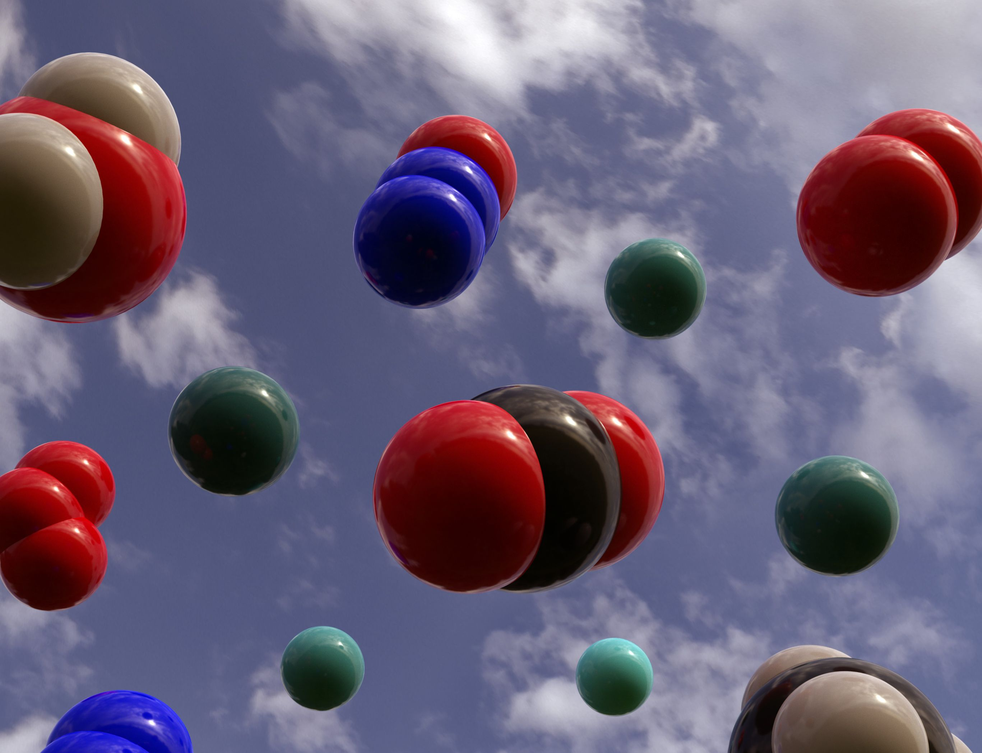
The Kinetic Theory of Gases

Slide 2
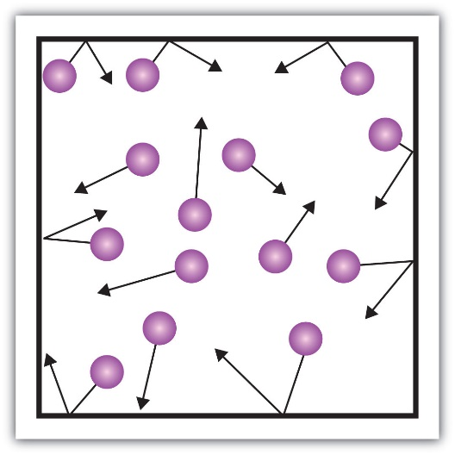

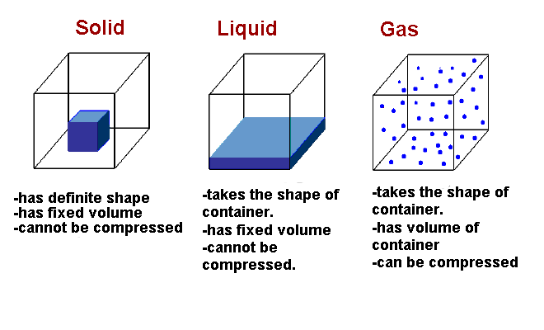
Review: Properties of phases of matter

Slide 3
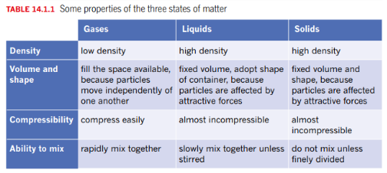
Review: Properties of phases of matter

Slide 4
Phet simulation – kinetic molecular theory
The experimental observations (and your simulation observations) about the behaviour of gases can be explained with a simple theoretical model known as the kinetic molecular theory.
The theory of kinetic molecular theory applies to ideal gases but are a useful model to explain the behaviour of real gases provided you appreciate it’s limitation and assumptions.

Slide 5
Postulates of the Kinetic Theory of Gases
Gases are composed of a large number of particles that behave like hard, spherical objects in a state of constant, random motion.
These particles move in a straight line until they collide with another particle or the walls of the container.
These particles are much smaller than the distance between particles. Most of the volume of a gas is therefore empty space.
There is no force of attraction between gas particles or between the particles and the walls of the container.
Collisions between gas particles or collisions with the walls of the container are perfectly elastic. None of the energy of a gas particle is lost when it collides with another particle or with the walls of the container.
The average kinetic energy of a collection of gas particles depends on the temperature of the gas and nothing else.

Slide 6
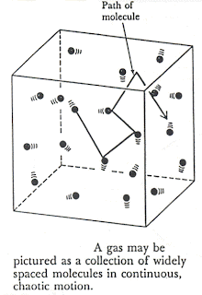
Postulates of the Kinetic Theory of Gases
1.
Gases are composed of a large number of particles that behave like hard, spherical objects in a state of constant, random motion.

Slide 7
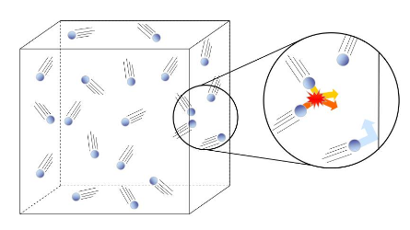
Postulates of the Kinetic Theory of Gases
2.
These particles move in a straight line until they collide with another particle or the walls of the container.

Slide 8
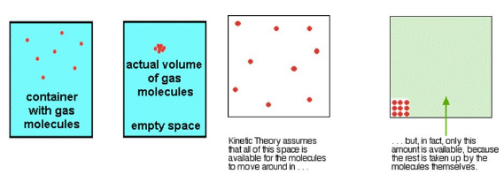
Postulates of the Kinetic Theory of Gases
3.
These particles are much smaller than the distance between particles. Most of the volume of a gas is therefore empty space.

Slide 9
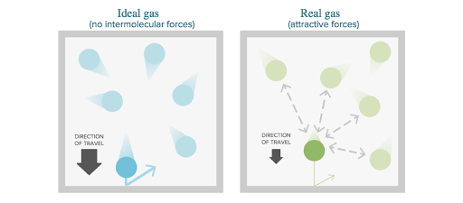
Postulates of the Kinetic Theory of Gases
4.
There is no force of attraction between gas particles or between the particles and the walls of the container.

Slide 10
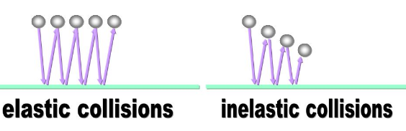
Postulates of the Kinetic Theory of Gases
5.
Collisions between gas particles or collisions with the walls of the container are perfectly elastic. None of the energy of a gas particle is lost when it collides with another particle or with the walls of the container.

Slide 11
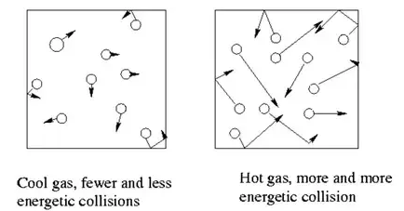
Postulates of the Kinetic Theory of Gases
6.
The average kinetic energy of a collection of gas particles depends on the temperature of the gas and nothing else.

Slide 12
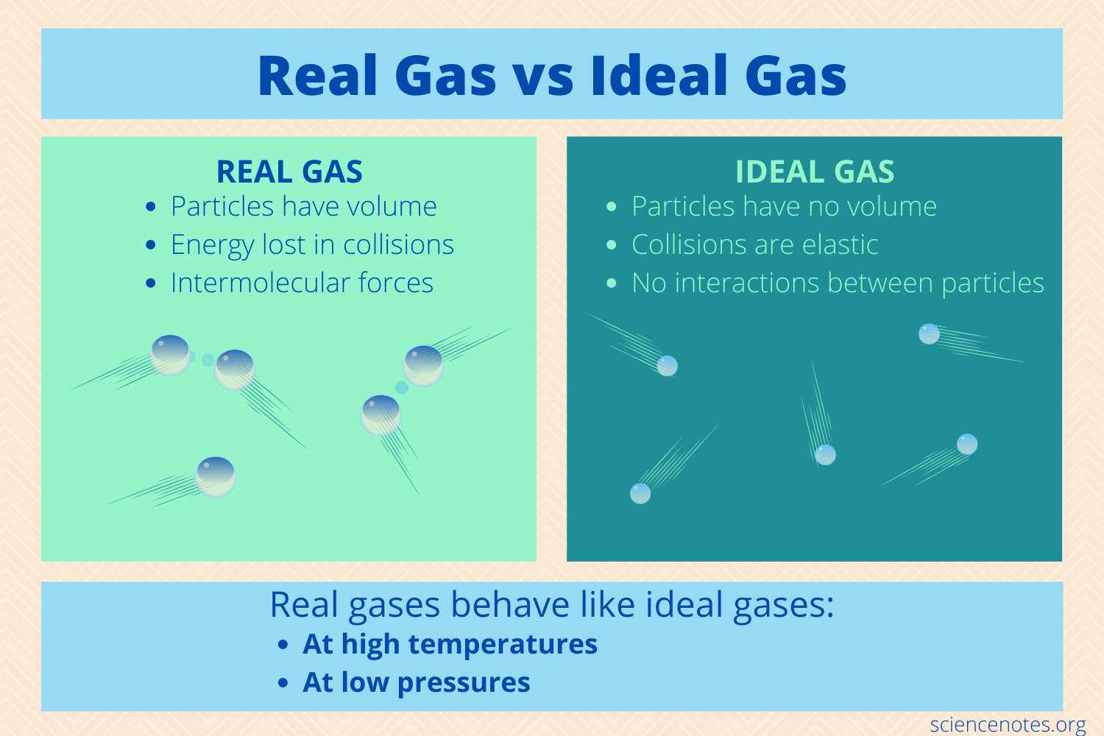
Ideal gases vs Real gases

Slide 13
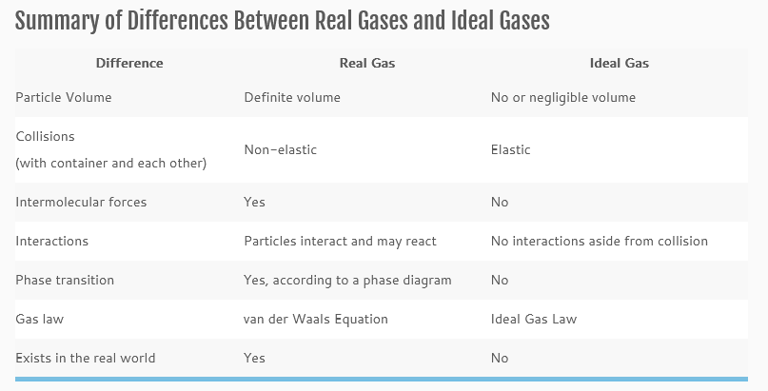
Ideal gases vs Real gases

Slide 14
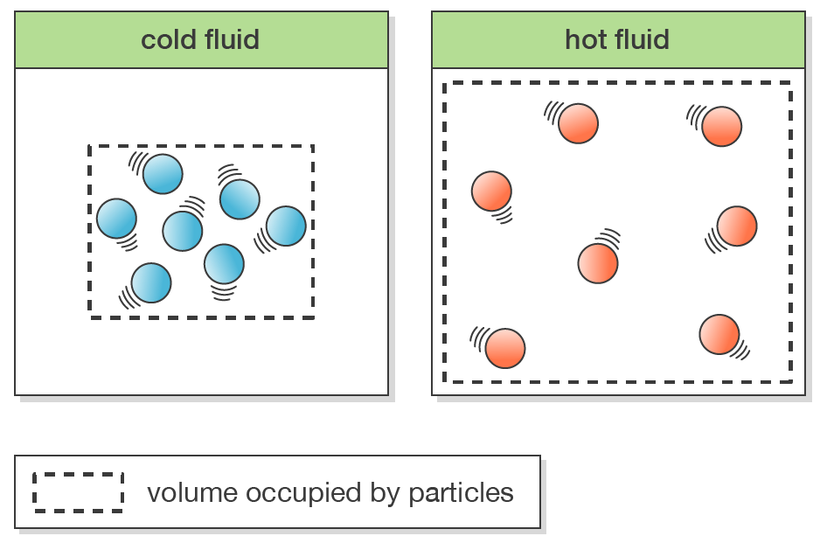

Key properties
Temperature:
  Temperature is directly proportional to average kinetic energy
  Average kinetic energy is independent of the nature of the gas, i.e. hydrogen gas and oxygen gas will have the same average kinetic energy if they are at the same temperature
  It is an average, individual particles can have different amounts of kinetic energy (see Maxwell-Boltzmann distribution graph later in presentation)
  Units: degrees Celsius and Kelvin

Slide 15
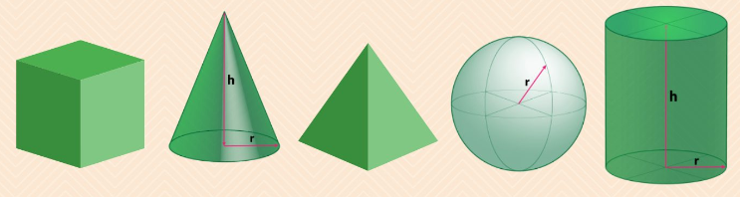
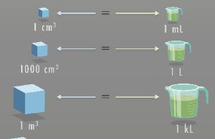
Key properties
Volume:
  Used to describe the space that a substance occupies
  Units: Litre (L), milliLitre (mL), cubic metre (m³) and cubic centimetre (cm³)

Slide 16
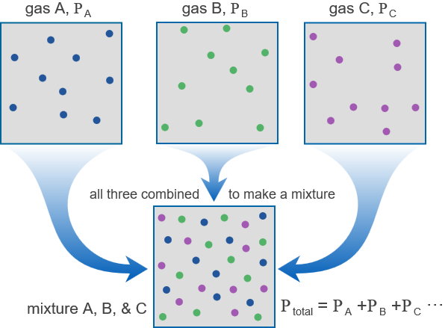
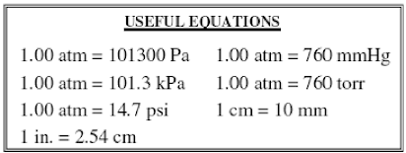
Key properties
Pressure:
  For KMT pressure is the force exerted on a unit area of a surface by the particles of gas as they collide with the surface
  More particles in a certain volume, the greater the frequency of collisions so the higher the pressure
  For a mixture, you can calculate the partial pressure of the individual gases and combined they give the total pressure of the system
  Units: kPa (there are lots, this is one WACE uses)

Slide 17
Use the Kinetic Theory to explain the following observed property of gases.
As the number of molecules in a container increases the pressure will increase?
  Gas pressure will increase because of the increasing frequency of collisions with the walls of the container. More molecules will mean an increasing number of collisions per second with the container walls and so a higher pressure will be recorded.

Slide 18
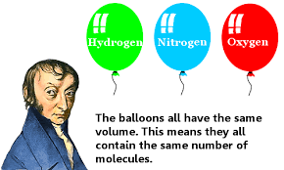
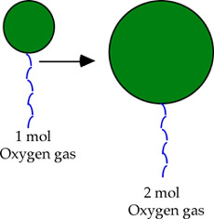
Avogadro's gas law
From previous slide: volume is constant, we add more particles (ie number moles increased) then the pressure increases – directly proportional
SO….
If the pressure is constant, then increasing particles will result in an increased volume!
Avogadro found if you know the volume then you know the amount of gas! If the pressure and temperature are constant.

Slide 19
Use the Kinetic Theory to explain the following observed properties of gases.
When two gases are mixed in a container the pressure of the mixture will be equal to the sum of the pressures of the individual gases as if they were the only gas present in the container?
  The two sets of gas molecules will not affect each other. The pressure on the walls of the container will only be due to the number of molecules of each gas present. The total pressure is simply the sum of the partial pressure of each gas.

Slide 20
Partial pressure concept

Slide 21
Use the Kinetic Theory to explain the following observed properties of gases.
As the volume of the container is reduced for a fixed amount of gas, the pressure increases.
  When the volume is smaller the gas molecules will collide more frequently with the walls of the container, which means a higher pressure.

Slide 22
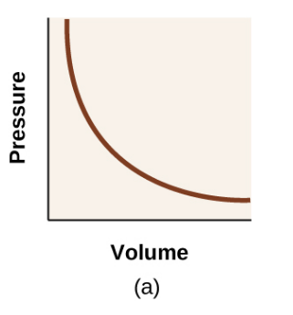
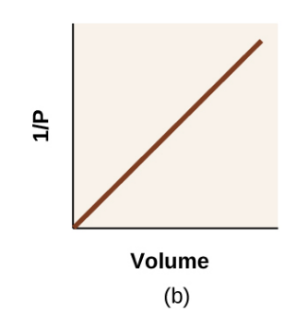

Boyle’s Law
If amount of gas and temperature are constant, if there is an increase the volume then the pressure will decrease – inversely proportional

Slide 23
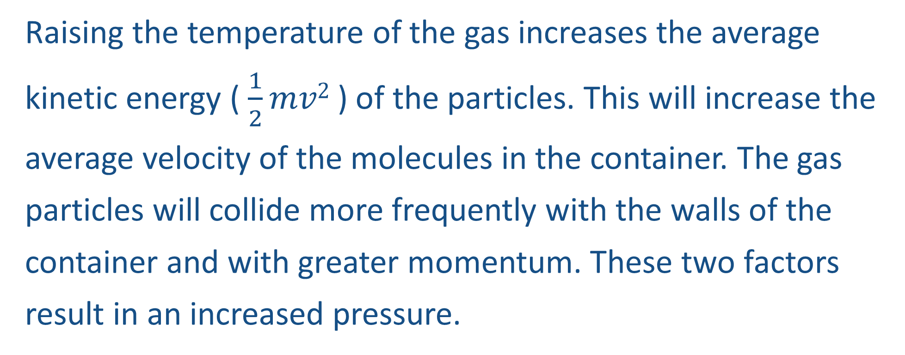
Use the Kinetic Theory to explain the following observed properties of gases.
When the temperature is increased the pressure of the gas will increase?
  Raising the temperature of the gas increases the average kinetic energy ( $\frac{1}{2}mv2$ ) of the particles. This will increase the average velocity of the molecules in the container. The gas particles will collide more frequently with the walls of the container and with greater momentum. These two factors result in an increased pressure.

Slide 24
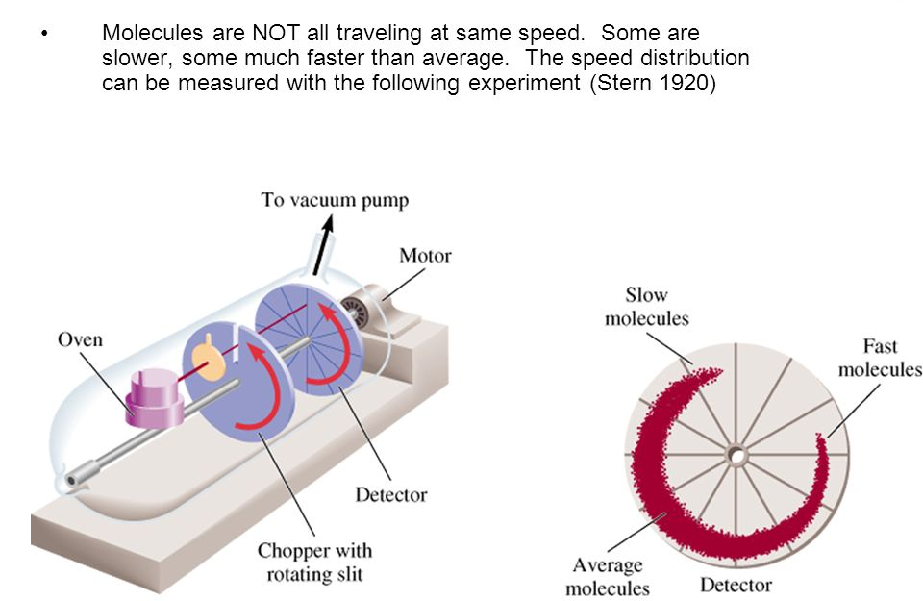
Measuring molecular speeds

Slide 25
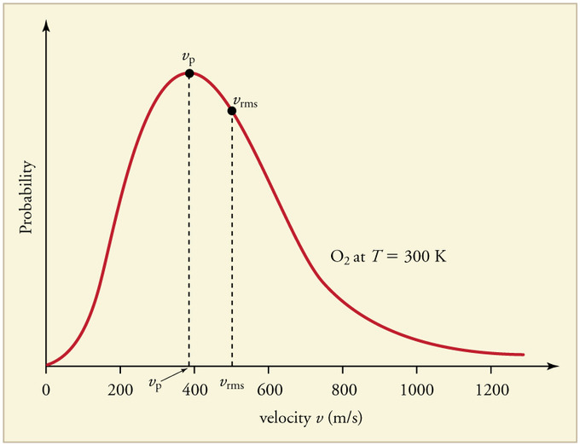
Not all molecules have the same energy
Others not so much
Some have lots

Slide 26
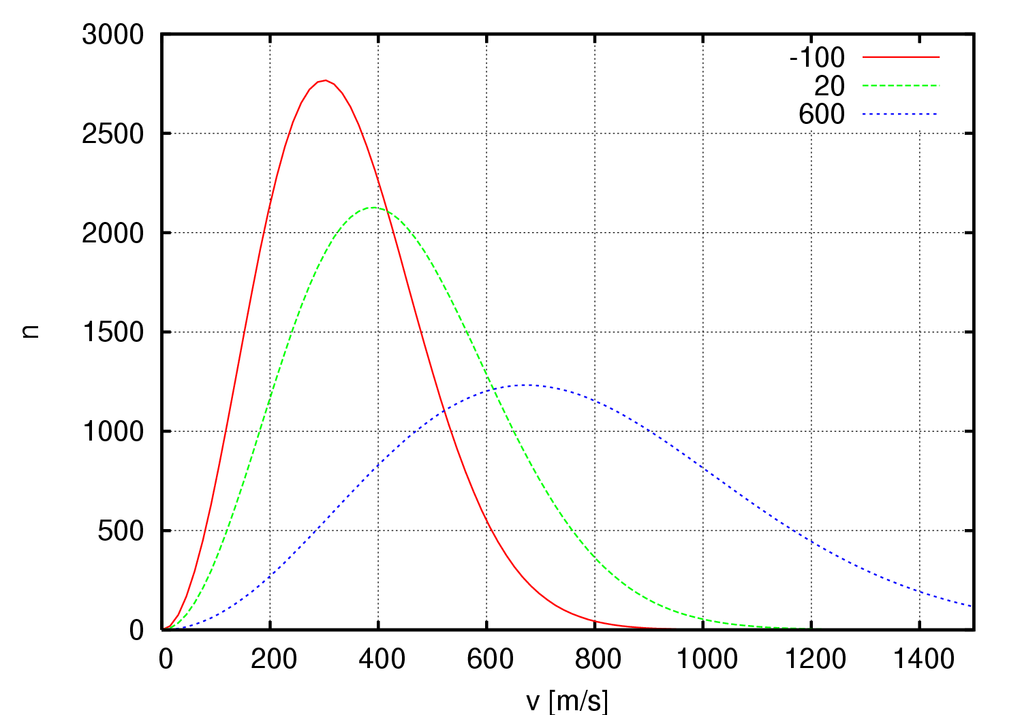

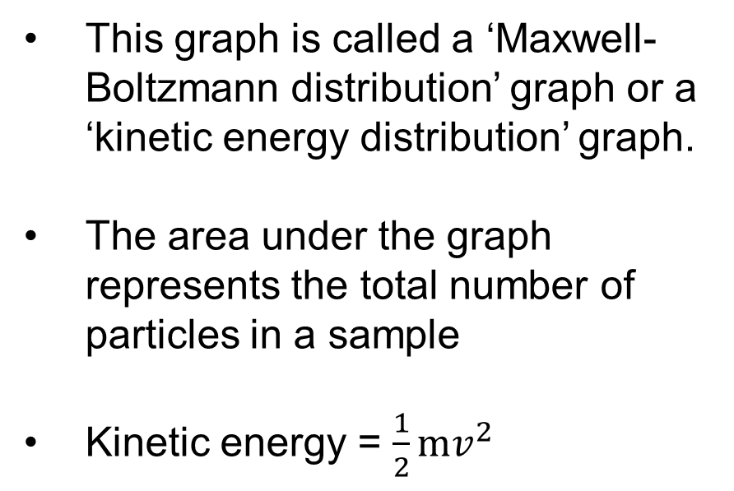
Raising the temperature changes the distribution
This graph is called a ‘Maxwell-Boltzmann distribution’ graph or a ‘kinetic energy distribution’ graph.
The area under the graph represents the total number of particles in a sample
Kinetic energy = $\frac{1}{2}mv^{2}$
m = mass, v = velocity
so, at a given temperature heavier particles will have on average a slower velocity

Slide 27
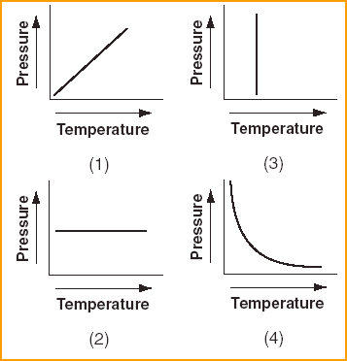
OK which is the correct graph

Slide 28


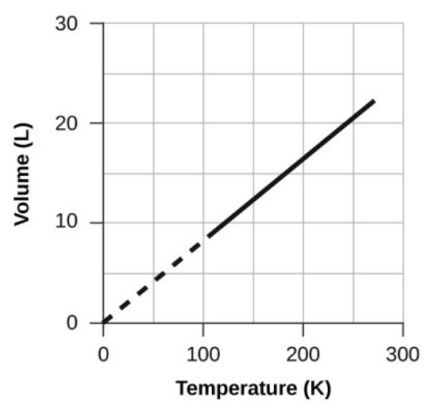
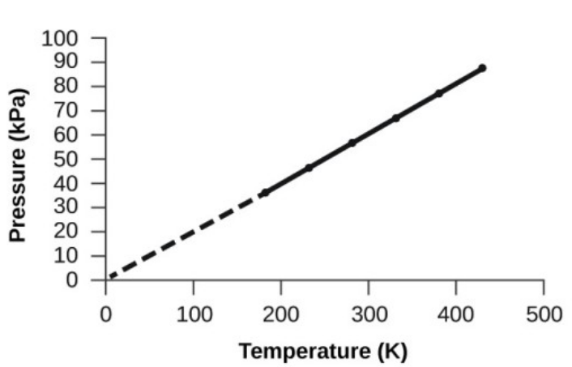
More laws…
Gay-Lussac’s Law
(also called Amonton’s Law)
Charles’ Law
For constant volume and amount of gas, the pressure of a gas is directly proportional to its temperature (in kelvin).
For constant pressure and amount of gas, the volume of a gas is directly proportional to its temperature (in kelvin).

Slide 29
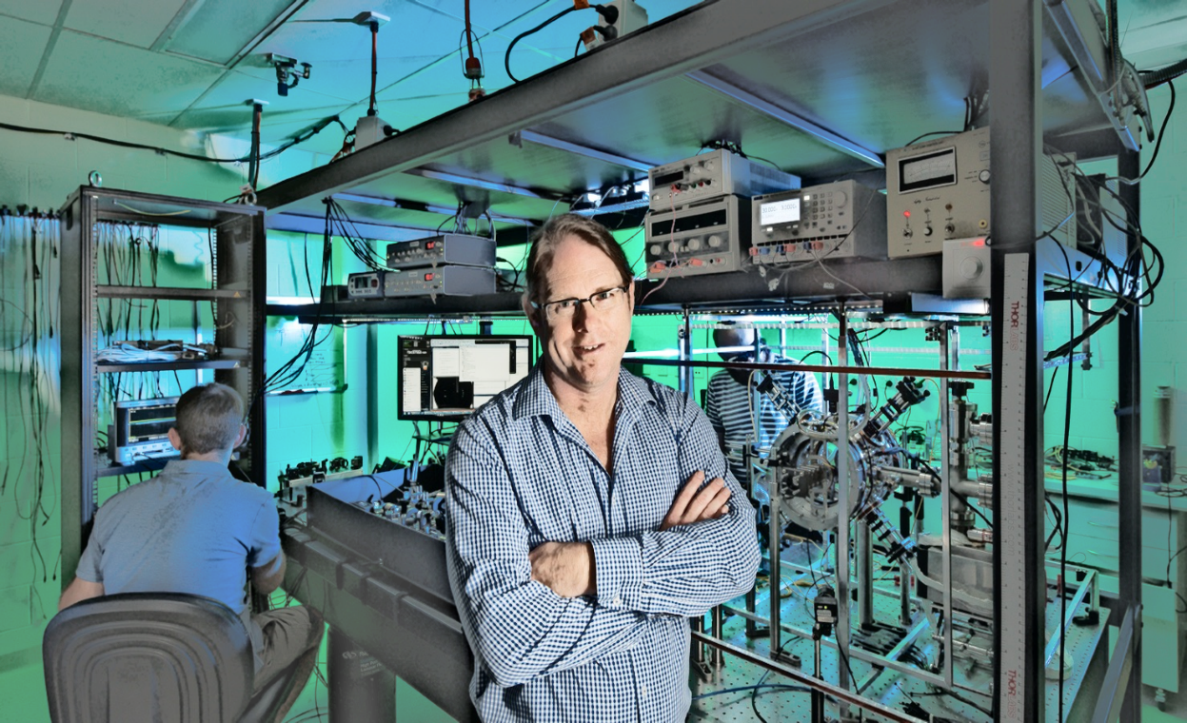

How cold can we go?
At -273 C or O K the volume of an ideal gas would be zero
This is because the particles would be travelling at the slowest speed possible. ( 0 ms⁻¹ )
This is the coldest temperature that there is. Scientists have achieved temperatures of 0.1K.
Ex RSHS student Andre Luiten built the worlds most accurate clock at UWA

Slide 30
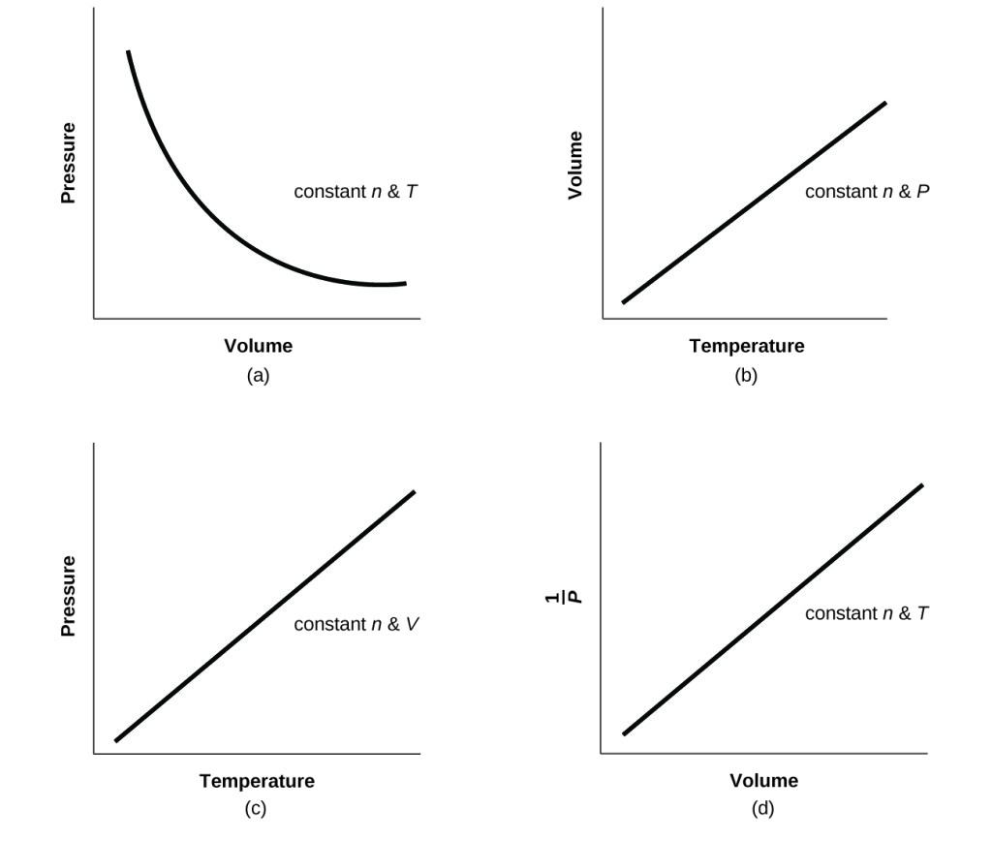
In summary

Slide 31
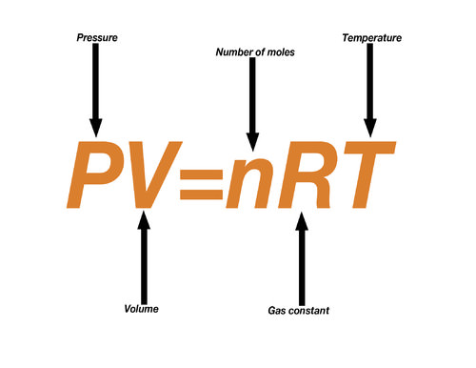
Videos and future work
https://www.youtube.com/watch?v=o3f_VJ87Df0
https://www.youtube.com/watch?v=robEY-idcLU
Ideal gas law – we will be learning to use this relationship tomorrow.

